Slide 1
Issues in Knowledge Representation
INT404

Slide 2
Issues in Knowledge Representation
  Are any attributes of objects so basic that they occur in almost every problem domain? If there are, we need to make sure that they are handled appropriately in each of the mechanisms we propose. If such attributes exist, what are they ? (example isa, instance)
  Are there any important relationships that exist among attributes of objects?
  At what level should knowledge be represented? Is there a good set of primitives into which all knowledge can be broken down? Is it helpful to use such primitives?
  How should set of objects be represented?
  Given a large amount of knowledge stored in a database, how can relevant parts be accessed when they are needed?

Slide 3
Knowledge Representation
1. Important Attributes
  There are two attributes that are of very general significance, and we have already seen their use; instance and isa.
  These attributes are important because they support property inheritance.
2. Relationship among attributes
Attributes that use to describe objects are themselves entities we represent they have some properties as:
  Inverses
  Existence in an isa hierarchy
  Techniques for reasoning about values
  Single-values attributes

Slide 4
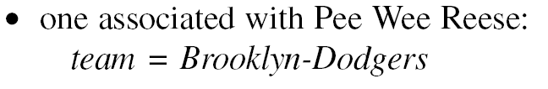

Representing Inverses
→ Represent both relationships in a single representations that ignore focus :
Can equally easily be interpreted as a statement about Pee Wee Reese or
about Brooklyn Dodgers.
→ Use attributes that focus on single entity but to use them in pairs, one the inverse of other.
90

Slide 5
An Isa Hierarchy of Attributes
Just as there are classes of objects and specialized subsets of those classes,
There are attributes and specializations of attributes.
Consider, for example, the attribute height. It is actually a specialization of more
general attribute physical-size which is, in return a specialization of physical-attribute.
The generalization-Specialization relationship is important because they support
Inheritance. (class-class: isa, class-member: instance
Technique for reasoning about values
Some time value of attributes are specified explicitly when a knowledge base is created.
Information about the type of value. (value of height must be number measured in length).
Constraints on the value. (age of person not greater than age of his parents)
Rules for computing the value when it is needed.(backward rules or if needed rules
Rules that describe actions that should be taken if a value ever becomes known. (forward rules or if-added rules)

Slide 6
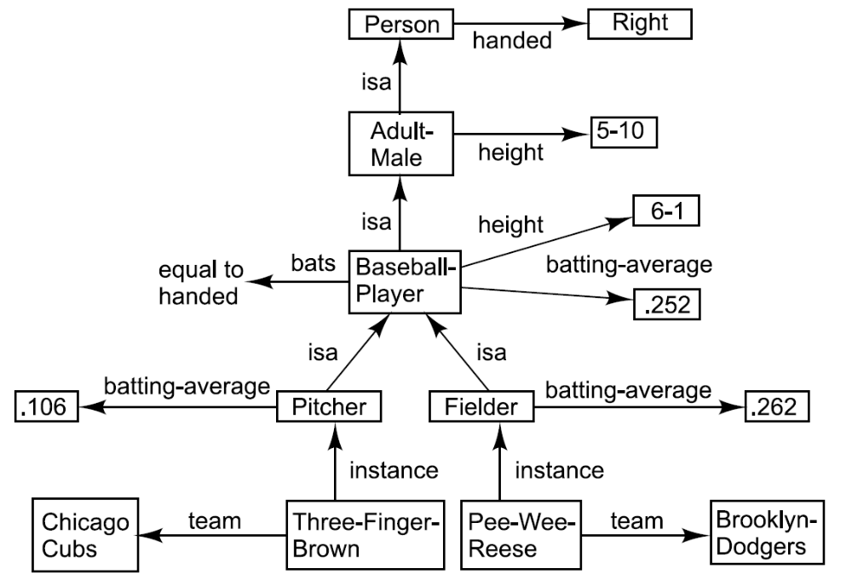
Inheritable Knowledge

Slide 7
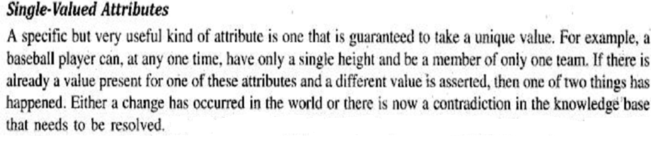
3. Choosing the Granularity of the Representation
It is necessary to answer the question “At what level of detail should the world be
Represented?”
Another way this question is phrased is “what should be our primitives?”

Slide 8

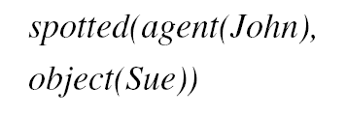

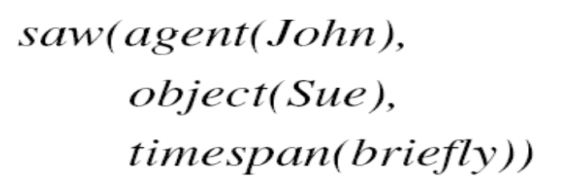
Choosing the Granularity of the Representation
Suppose we are interested in the following fact :
We could represent this as
Questions :
Who spotted Sue?
(easy to answer “Jon”)
Did John see Sue?
( The obvious answer is “YES” but given only one fact can not answer, So We could add facts, spotting is really a special type of seeing explicitly in representation of the fact.)
An alternative representation:
We have broken the idea of spotting apart
Into more primitive concepts of seeing and
Time span.
91

Slide 9

Are There Primitive Concepts
Primitive: mother, father, son, daughter,
brother and sister
Mary is Sue’s cousin.
An alternative:
Primitive: parent, child, male, female and sibling
93

Slide 10
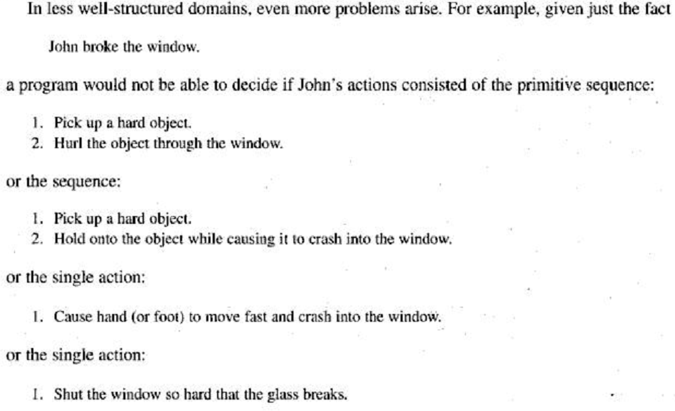

Slide 11
4. Representing set of objects
It is important to be able to represent sets of objects for several reasons.
  There are some properties that are true of sets that are not true of the individual member of sets. E.g. “there are more sheep then people in Australia” and “English speakers can be found all over the world.”
  If a property is true of all(or even most) elements of a set, then it is more efficient to associate it once with the set rather than to associate it explicitly with every element of the set.
  The simplest ways in which sets may be represented. is just by name. e.g. Baseball-player

Slide 12
There are two ways to state a definition of a set and its element:
1.Extensional : list the members
2. Intensional: provide a rule that, when a particular object is evaluated, return true or false depending the object is in the set or not.
Ex:-
extensional description of the set of our sun’s planets on which people live is {earth}
and intensional description is
extensional defined set {earth} has many intensional definitions
94

Slide 13
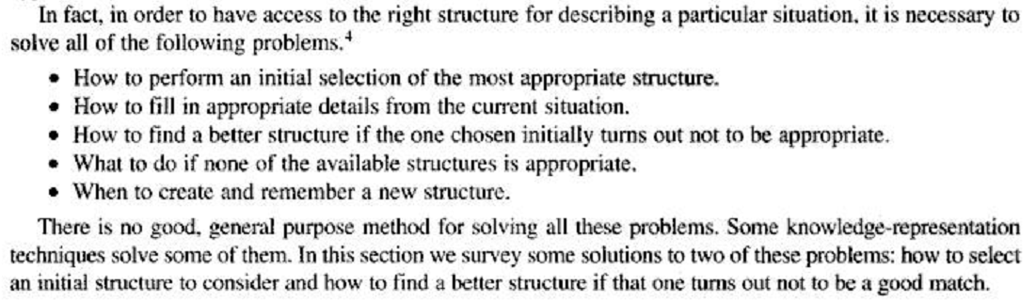
5. Finding a right structures as Needed

Slide 14
Selecting an Initial Structure
Index structures by English words
- John flew to New York.
* He rode in a plane from one place to another.
- John flew a kite.
* He held a kite that was up in the air.
- John flew down the street.
* He moved very rapidly.
- John flew into a rage.
* An idiom.
Index structures by concepts
Use one major clue.
95

Slide 15
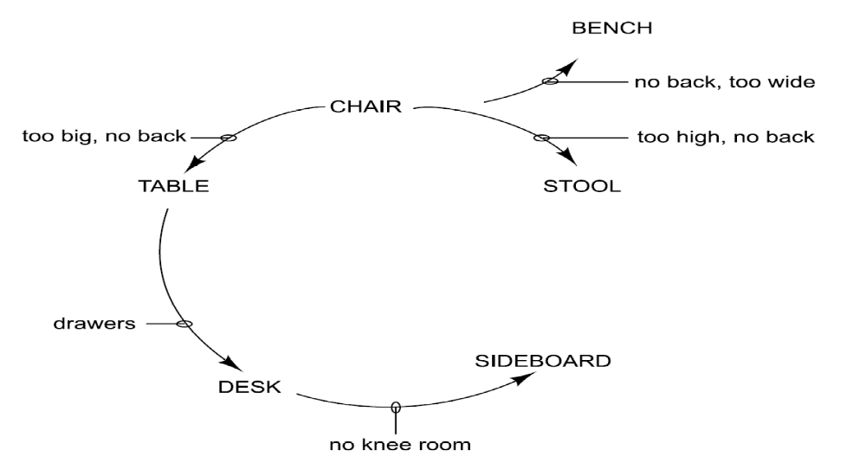
Revising the choice when necessary:
A Similarity Net
96

Slide 16
The Frame Problem
Representing the state
- Store all the facts at each node.
* Problem : a lot of facts get represented a lot of times.
For a robot world it require copy the fact “above (Ceiling, Floor)” at
each Node
The Whole problem of representing the facts that change as well as those that do not is known as the frame problem.
- Do not modify the initial state description at all. Store a representation of the changes.
- Modify the state but record how to undo.
Computing the new state : Frame axioms

Slide 17
Thank You!!!

